Slide 1

Orion
Conversational AI for Educational Support
Department of Computer Science & engineering IET Lucknow
Submitted By:
Name 1 : Siddharth Singh Roll No-2200520100061
Name 2 : Shoumyadeep Roy Roll No-2200520100060
Name 2 : Hensi Avdesh Kumar Baghel Roll No-2200520100027
Guided by:
Name of supervisor : Prof. Vineet Kansal Name of co- supervisor : Mr. Abhishek

Slide 2
Agenda
Introduction
Motivation
Objective & Problem Statement
Literature Survey
Methodology
Implementation
Result
Conclusion
Future Scope
References

Slide 3


Introduction
ORION is an AI-powered conversational platform designed to improve learning and knowledge retrieval using natural language interactions.
Conversational AI Relevance
Intelligent Learning Assistance
Provides personalized explanations, document understanding, AI chat interaction, and context-aware responses.
Interdisciplinary Approach
Combines Conversational AI, Retrieval-Augmented Generation (RAG), Natural Language Processing (NLP), Cloud Services, and Web Technologies for intelligent interaction.

Slide 4
Objective & Problem Statement
Problem Statement
To develop an intelligent conversational AI platform capable of understanding user intent, retrieving contextually relevant information from multiple sources, and generating accurate, meaningful, and personalized responses to improve learning and knowledge accessibility.
Study Objectives
• Create an AI-powered intelligent assistant for learning and information retrieval • Improve contextual understanding of user queries • Enable interactive personalized responses • Integrate document-based knowledge retrieval

Slide 5

Literature Survey
References | Findings | Method Used | Contribution | Important Features | Drawback
Lewis et al. (2020) – RAG | Combines external knowledge with LLMs for improved factual responses | Retrieval-Augmented Generation | Reduces hallucination and improves contextual accuracy | Dense retrieval, external knowledge integration, context grounding | Increased retrieval latency.
Karpukhin et al. – Dense Retrieval | Dense vector retrieval improves semantic search | Bi-Encoder + Dense Retrieval | Better contextual document retrieval | Semantic embeddings, vector similarity search | High computational cost
Weizenbaum (ELIZA) → Modern LLM Systems | Conversational systems evolved from rule-based to neural systems | Transformer-based Conversational AI | Human-like multi-turn interactions | Context understanding, dialogue management | Context retention limitations.
Clarizia et al. (2018), Ranoliya et al. (2017) | Academic chatbots improve engagement | FAQ Chatbots + NLP | Improved student support systems | Automated assistance, personalized interaction | Poor handling of unstructured documents.

Slide 6
Dataset
The dataset used for ORION is based on publicly available benchmark datasets including Stanford Question Answering Dataset (SQuAD) and MS MARCO, which are widely used for Natural Language Processing and Information Retrieval research.
SQuAD contains more than 100,000 question-answer pairs extracted from Wikipedia articles, while MS MARCO contains over 1 million real-world search queries and relevant passages collected from Bing search logs.
Source
Dataset | Data Type | Size | Purpose in Orion | Source
SQuaD | Question–Answer Pairs | 100,000+ | Context understanding and QA evaluation | Stanford University
MS MARCO | Search Queries + Passages | 1M+ | Retrieval and semantic search evaluation | Microsoft Research
SQuAD | Text Documents | Wikipedia Articles | Context understanding, dialogue management | Stanford University
MS MARCO | Passage Collection | Large-scale text corpus | Information retrieval | Microsoft Research

Slide 7
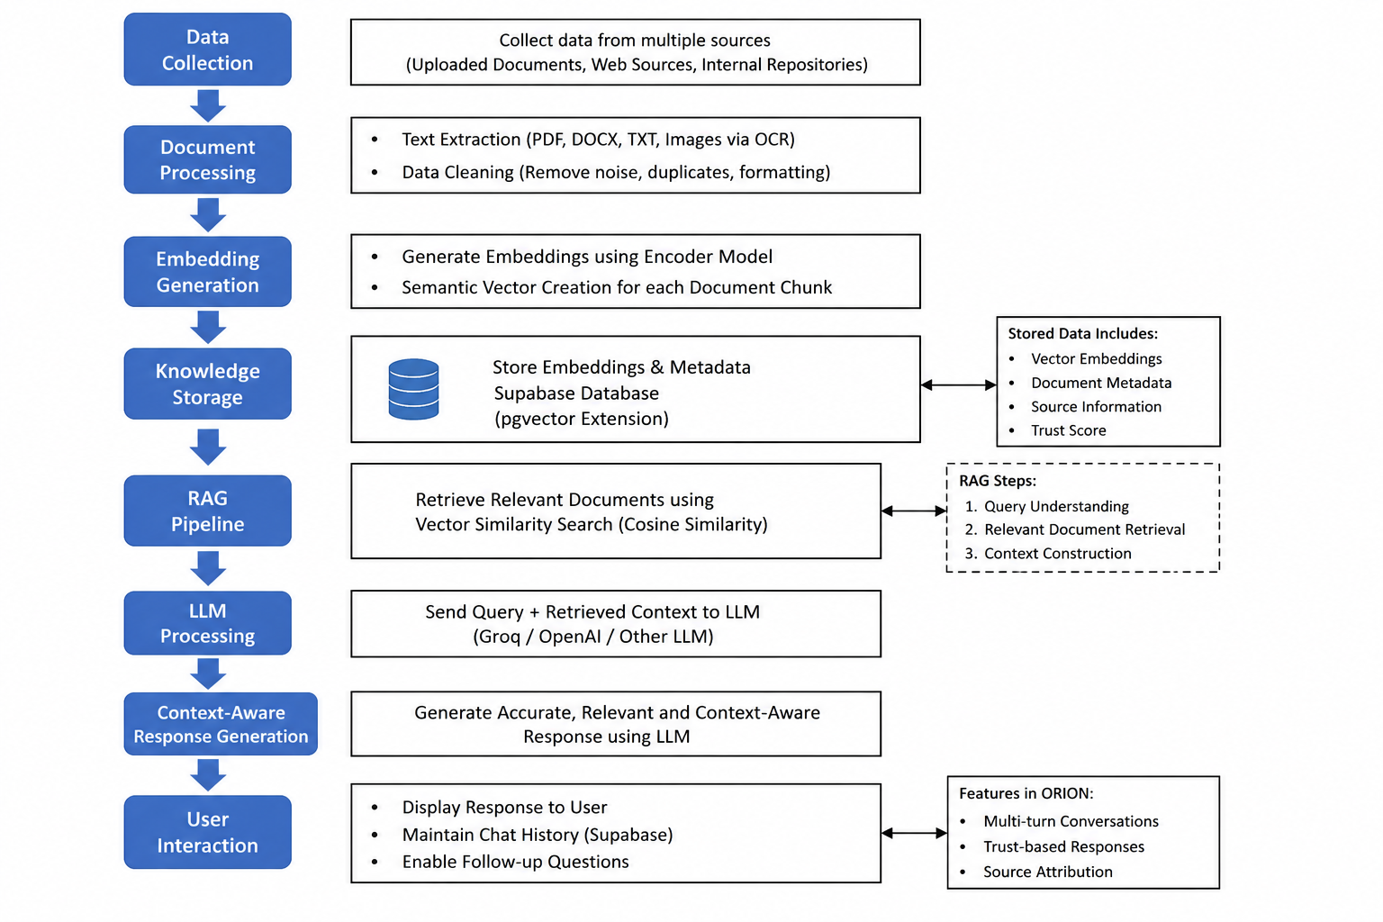
Existing / Proposed Methodology

Slide 8





Implementation
AI Model
Conversational LLM integration
Context-aware response generation
RAG-based retrieval system
Backend
- FastAPI backend architecture
User Interface
- Next.js frontend
- API handling and model routing
- Tailwind CSS styling
User Interface
- Interactive chatbot interface
- Database connectivity
- Theme support (Dark / Light)

Slide 9
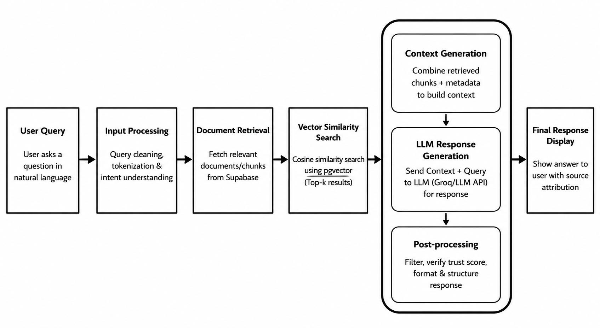
Implementation

Slide 10
Result
Successfully integrated conversational AI with document retrieval capability into a unified system. This allows users to interact naturally while retrieving relevant information from uploaded documents.
Implemented context-aware intelligent response generation using Retrieval-Augmented Generation (RAG). The system generates responses by combining user queries with retrieved contextual information.
Built an interactive and responsive user interface using Next.js and Tailwind CSS technologies. The interface provides smooth navigation, improved usability, and an enhanced user experience.
Achieved faster and more accurate information retrieval using vector embeddings and similarity search techniques. Semantic retrieval improves relevance by identifying contextually related information instead of exact keyword matches.
Improved overall user experience through personalized interaction and conversational assistance. Users can receive adaptive responses while maintaining contextual continuity during interactions.

Slide 11
Conclusion
ORION provides a modern AI-based learning assistant system designed to simplify knowledge retrieval and user interaction. It offers an intelligent and dynamic platform for accessing information effectively.
Context-aware retrieval improves the relevance and accuracy of responses generated by the system. This ensures users receive meaningful information based on their queries and available documents.
Integration of Retrieval-Augmented Generation (RAG) architecture helps reduce misinformation and hallucination issues. By grounding responses in retrieved knowledge sources, reliability is significantly improved.
The system enhances learning efficiency and overall user interaction through conversational AI capabilities. Users can communicate naturally and obtain personalized responses in real time.
The modular architecture of ORION enables scalability and supports future feature expansion. This design allows easy integration of additional technologies and functionalities.

Slide 12

Future Scope
Deployment of larger AI models
Integration with educational platforms
Improved memory and context retention
Advanced personalization system
Multi-language communication
Voice-based interaction support

Slide 13
References
Lewis, P., Perez, E., Piktus, A., Petroni, F., Karpukhin, V., Goyal, N., ... & Kiela, D. (2020). Retrieval-Augmented Generation for Knowledge-Intensive NLP Tasks. Advances in Neural Information Processing Systems (NeurIPS), 33, 9459–9474.
Karpukhin, V., Oğuz, B., Min, S., Lewis, P., Wu, L., Edunov, S., ... & Yih, W. T. (2020). Dense Passage Retrieval for Open-Domain Question Answering. Proceedings of EMNLP, 6769–6781.
Vaswani, A., Shazeer, N., Parmar, N., Uszkoreit, J., Jones, L., Gomez, A. N., ... & Polosukhin, I. (2017). Attention Is All You Need. Advances in Neural Information Processing Systems (NeurIPS), 30.
Brown, T., Mann, B., Ryder, N., Subbiah, M., Kaplan, J. D., Dhariwal, P., ... & Amodei, D. (2020). Language Models are Few-Shot Learners. Advances in Neural Information Processing Systems (NeurIPS), 33, 1877–1901.
Clarizia, F., Colace, F., Lombardi, M., Pascale, F., & Santaniello, D. (2018). Chatbot: An Education Support System for Student. International Symposium on Cyberspace Safety and Security, 291–302.
Ranoliya, B. R., Raghuwanshi, N., & Singh, S. (2017). Chatbot for University Related FAQs. ICACCI, 1525–1530.
Reimers, N., & Gurevych, I. (2019). Sentence-BERT: Sentence Embeddings using Siamese BERT-Networks. EMNLP, 3982–3992.
UNESCO. (2021). AI and Education: Guidance for Policy-makers. United Nations Educational, Scientific and Cultural Organization.

Slide 14
Thank you

